Slide 1

Feed Forward neural network
Individual presentation
DHANESH RAJU 2311363

Slide 2


Agenda
DATA PROCESSING
ARCHITECTURE/TOPOLOGY
PARAMETERS FOR NETWORK
RMSE AND EARLY STOPPING CRITERIA
CONNECTING WITH GAME

Slide 3
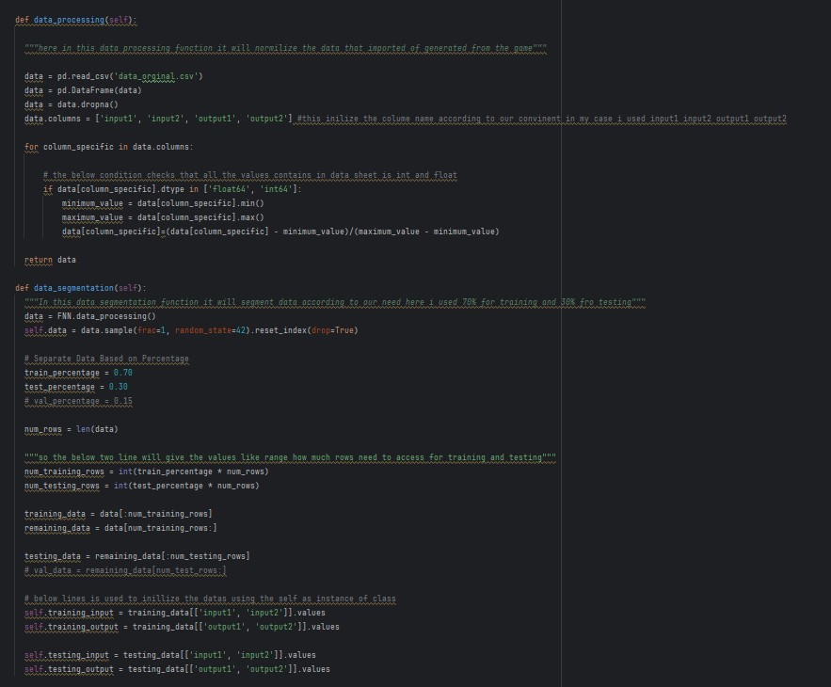
Data processing:
Here in data processing, I’ve loaded data file using Pandas I’m checking if there is any null values present if yes then I’ll drop it then do normalization of date by finding the maximum and minimum of the all-column’s present in data sheet.
In data Partition I give 70%for training the network and 30% for testing the network

Slide 4
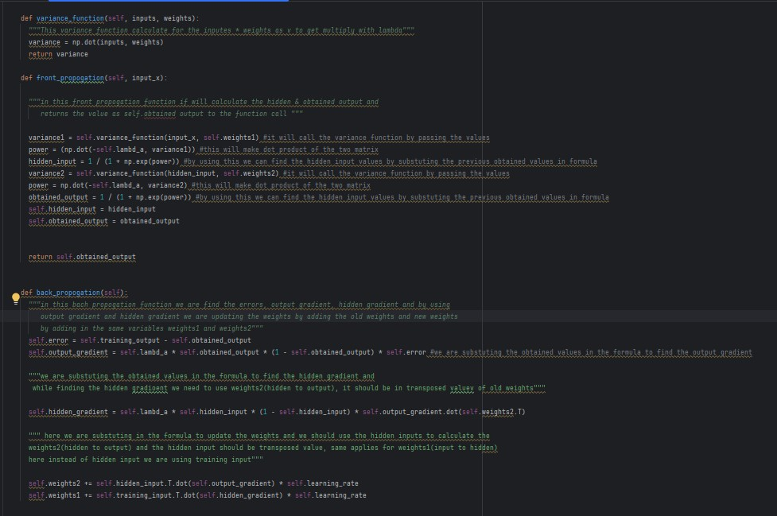
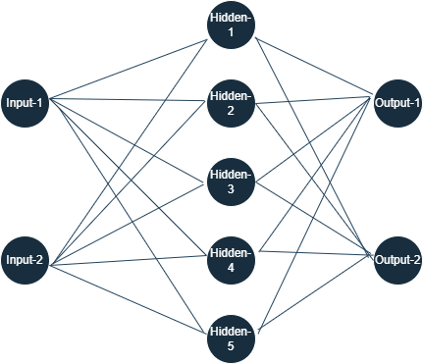
Architecture/Topology:
Here in Architecture, I’ve created 1 Input layer with 2 Input nodes, 1 Hidden layer with 5 Hidden nodes and 1 Output layer with 2 Output nodes.
This neural network comprises an input layer, one or more hidden layers, and an output layer. It is often referred to as a Multilayer Perceptron (MLP). ◦ The Size comparisons I used is (2,2,2),(2,5,2),(2,10,2),(2,20,10).

Slide 5
Architecture/Topology:
In this Architecture, I’ve created a single class called Neurons, To make the process and running easier and faster. So, I’ve setup model for single class.
This class contains of all
functions I used for the network basically this whole network run by the function calls and self-function is used to access all values through the whole code and in the class.

Slide 6

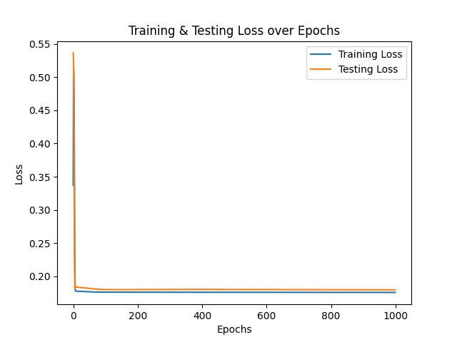
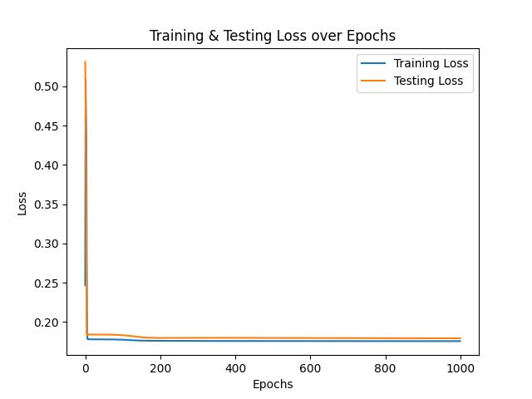
Parameters for network:
In my neural network I’ve used Lambda as 1, Momentum as 0.8, Learning Rate as 0.01, Epochs as 1000.
At 2nd attempt I set it as (0.5,0.5,0.08) it gives the same output as 1st attempt
At 3rd attempt I set it as (0.1,0.5,0.25) it gives the different output the has lots of difference between training and testing loss

Slide 7
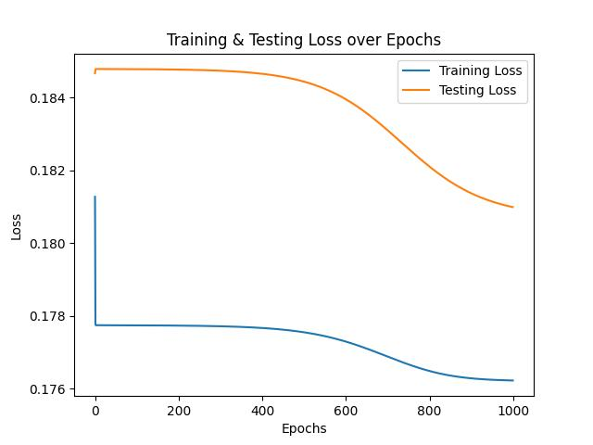
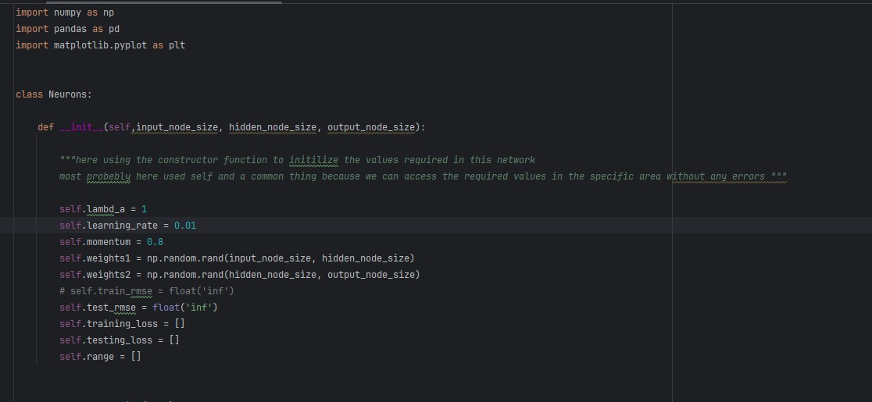
Parameters for network:
As I mentioned early, I’m using the self-function to access all values through whole code
The parameters are initialized in the Constructor created for the Class. So, this class also contain the weights for Input to Hidden(weights1) and Hidden to Output(weights2), and this weights are randomly generated at initial stage by using the NumPy random function and rand is used to generate from 0 to 1 only.

Slide 8
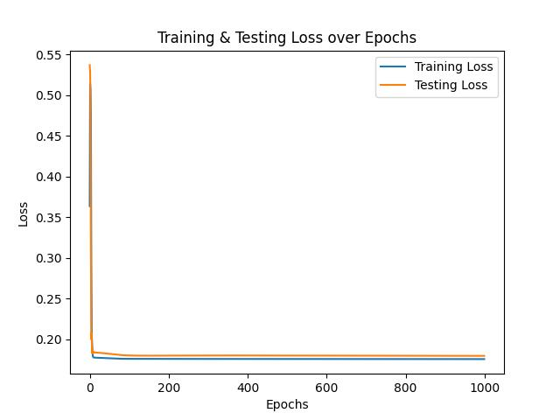
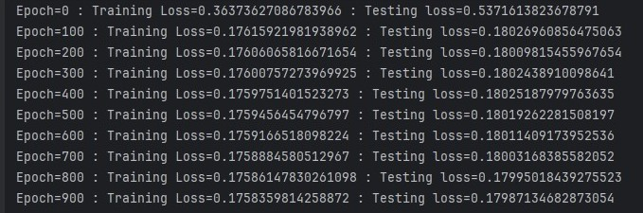
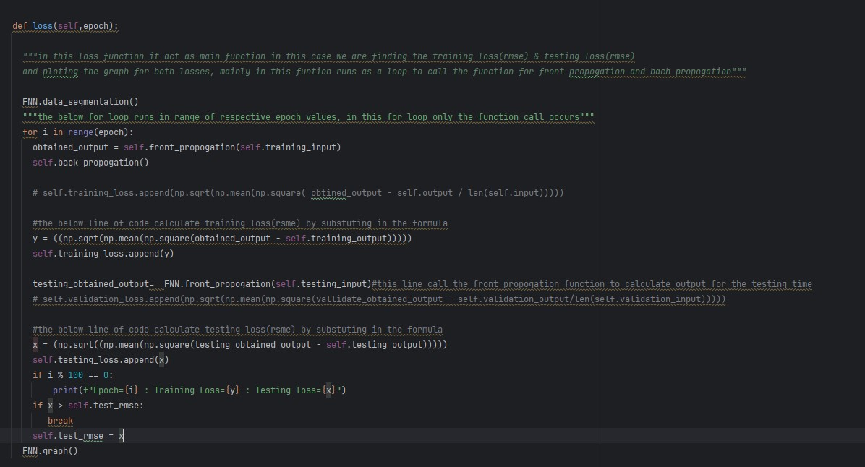
Rmse and early stopping criteria:
Here the Graph and RMSE values are shown in this slide the RMSE value is shown for every 100 Epoch
I’ve added the early stopping Criteria by passing break in the if-condition, If current testing loss is greater than previous testing loss The condition pass and it breaks the loop

Slide 9
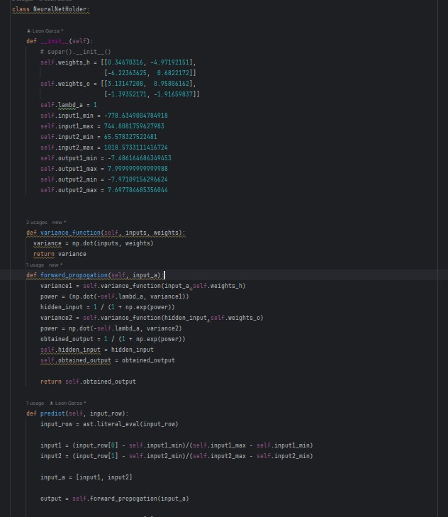
Connecting with game:
Here I’ve made the connection with the game by using the Updated weights, maximum and minimum values that I've calculated from the data sheet that generated by game
This bridge is built under Hardcoding and converting strings to float and input, normalizing the input, passing the normalized input to forward propagation and return output will be denormalized and returning it.

Slide 10


Innovation:
I’m Woking to implement this model in Quantum Computing by using the Quantum Computing Principle (Superposition, Entanglement, Decoherence). Why QC because, In normal computer we have bits (0 & 1) two combination but in qubits same (0 & 1) but four combinations (01,10,11,00).
Self-Supervised Learning: Right Now, this model can work with Structured Data, But we have tons of unstructured. So, working on this model, set to work in unstructured data by using Self-Supervised Learning.

Slide 11

THANK YOU
Dhanesh Raju
https://dhaneshraju.github.io/

